Slide 1
QF621 - Machine Learning-Enhanced Trading Strategies for TTF (Title Transfer Facility) Natural Gas Markets
Sample Group 7

Slide 2
Content
What is TTF and why we are looking into it
Data processing and model training
Trading strategy
Evaluation and refining
Conclusion

Slide 3

Objective of This Project
To develop and validate a systematic trading strategy for the TTF natural gas market using machine learning combining:
Fundamental Factors (demand, supply, and macroeconomic indicators),
Technical Indicators (price trends, momentum, volatility),
in order to optimize profitability and minimize risk.
This strategy will be evaluated via backtesting against historical data.

Slide 4
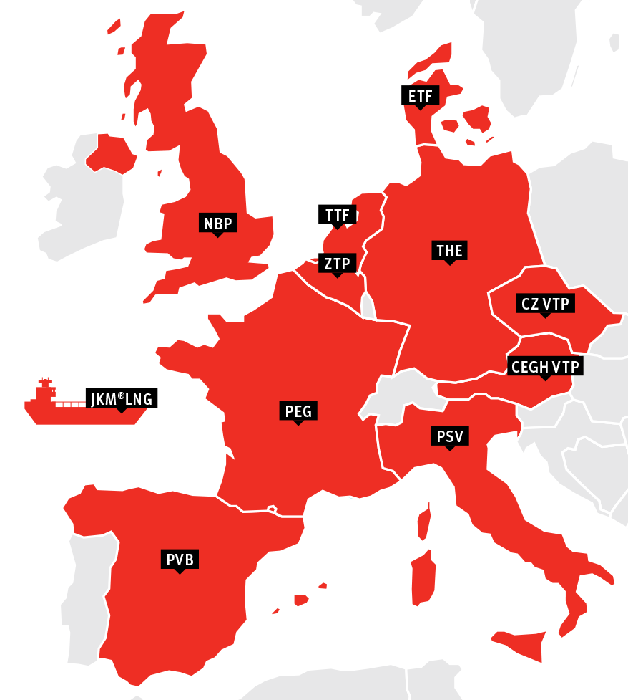
What is TTF?
(TTF) is a virtual trading point for natural gas in the Netherlands, serving as the primary benchmark for European gas prices.
Established by Gasunie in 2003, the TTF enables gas trading within the Dutch gas network and has grown to become the most liquid gas market in Europe.
Prices in the different trading hubs trade relative to the prices in TTF.
Eg. When prices in THE (Germany) trades at a premium to TTF due to shortages, gas traders can move the gas through pipelines to sell at THE therefore alleviating the shortage.

Slide 5
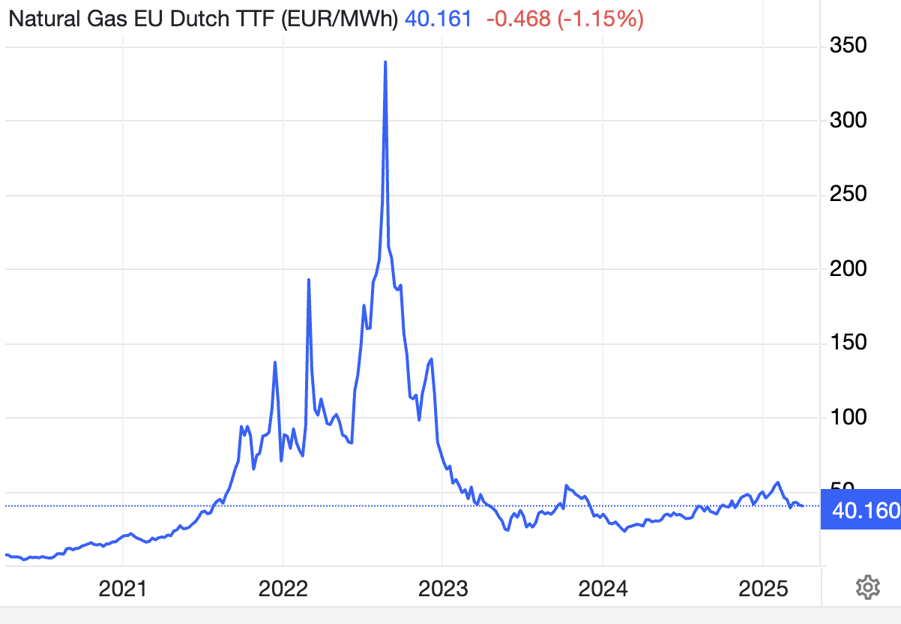
Why focus on TTF?
Market Significance:
TTF is the primary gas trading hub in Europe and a key benchmark for natural gas prices worldwide. (TTF, JKM, Henry Hub)
Volatility & Complexity:
The European energy market has been highly volatile due to geopolitical events, weather extremes, and evolving supply sources (e.g., LNG imports, renewable energy integration).
Rich Feature Space:
Complex interplay between demand, supply, macro trends, and sentiment.
Successfully predicting TTF prices could lead to significant trading opportunities, more efficient risk management, and better insights into European energy security and pricing dynamics.

Slide 6
What dataset did we use?
Historical TTF Front Month price data
Spot prices which influence storage movements trade relative to Front Month price
Price
Fundamentals
Demand: temperature: household demand, industrial demand, power stations
Supply: storage levels, LNG imports, interconnector flows
Macro
EUR/USD, crude oil, carbon and coal prices
Financial
NBP-TTF spread
*Data were taken from Bloomberg terminal in SMU

Slide 7
Why Front Month(FM) TTF Prices?
Gas Optimisation
Cause
Effect
Action
Sudden cold weather causes gas demand for heating to spike
BULLISH: Within Day(WD) Prices trade up and goes above Front Month
Withdraw the gas from storage and sell it into the market
High winds causes renewable energy production to spike
BEARISH: Within Day(WD) Prices trades downa and goes below Front Month
Buy gas from the market and inject it into storage
Example:
TTF May-25 is trading at 40 Euros/MWh
When WD trades at 38 Euros/MWh (2 Euros/Mwh below FM), inject into storage. You will have exposure (Long) in the FM leg of the contract and will need to hedge it.
Because of that many decisions are made relative to FM. Decisions are not made based on just WD prices as WD prices can be volatile.

Slide 8
Aim of the Presentation
By incorporating the fundamental factors into XGBoost and LSTM machine learning models, we aim to predict TTF Front Month’s price
Conduct a Cointegration and Correlation Test with key factors eg. Brent and Carbon
Implement a trading strategy using product spreads because fundamentally they have mean reverting properties

Slide 9
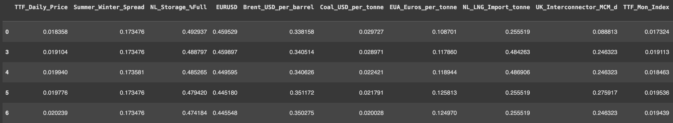
Data Preparation
Master_df:
A subset of relevant features
Removed rows with missing TTF price
Applied MinMax scaling to normalize all features between 0 and 1
Notes:
The first step we did, after pulling all the datasets from bloomberg was to integrate them to a master dataset based on dates. I began with a master dataset consisting of daily TTF prices and various macroeconomic, energy market, and weather indicators. To clean and structure the data:
I selected a subset of relevant features based on domain understanding.
Removed rows with missing values to ensure clean time series input.
Applied MinMax scaling to normalize all features between 0 and 1. The result dataframe as shown, This is crucial for LSTM performance since it’s sensitive to input scale.

Slide 10
Feature Selection
2. feature_cols:
Summer-Winter Spread
Netherlands Storage Percentage Full
Euro to US Dollar Exchange Rate (EUR/USD)
Brent Crude Oil Price in USD per Barrel
Coal Price in USD per Tonne
EUA Price in Euros per Tonne
Netherlands LNG Imports in Tonnes
UK Interconnector Flow in Million Cubic Meters per Day (MCM/d)
Title Transfer Facility (TTF) Monthly Index
Exchange Rate in Euro per Megawatt Hour (€/MWh)
UK-Netherlands Spread
Daily Temperature
Notes:
Here are the key features used:
Market indicators like Summer_Winter_Spread, Brent_USD_per_barrel, EUA_Euros
Currency exchange rates such as EURUSD
Energy supply/demand features like Netherlands Storage Percentage Full, Netherlands LNG Imports in Tonnes, and UK_Interconnector in MCM per day
Also a weather proxy: Daily_Temperature I initially included more technical indicators like moving averages and open interest but removed them after exploratory analysis didn’t show strong signal contribution. And now we are ready for training.

Slide 11
Model Selection
LSTM (Long Short-Term Memory):
Captures temporal patterns
Handles multi-feature time series well
Flexible and scalable with more data
XGBoost:
Strong performance on many datasets
Easy to interpret with feature importance
Fast to train and tune
Pros
Pros
Requires more data and compute
Harder to interpret
Sensitive to hyperparameters
Doesn’t model time dependencies natively
Requires feature engineering for lags
Can overfit without careful tuning
Cons
Cons
Notes:
I explored a few candidate models suited for time series and structured data. And I focused on two main approaches:
LSTM — for deep sequence modeling, and
XGBoost — as a strong baseline for tabular data.
LSTM (Long Short-Term Memory) networks are specialized for capturing long-term dependencies in sequential data. Unlike traditional models, it considers the order and evolution of features over time, which is critical for gas price prediction where trends and seasonality matter. LSTM has a special built-in gate mechanism, memory cells that help it "remember" or "forget" patterns across time steps. And on the other hand XGBoost is a gradient-boosted decision tree model that often performs very well on structured/tabular data. While not inherently sequential, it can still model time series by including lagged features manually

Slide 12
Sequence Construction
n_lag = 30
For example:
For day 31, the input sequence is from day 1 to day 30.
For day 32, it’s from day 2 to day 31.
X_all: (1271, 30, 13), y_all: (1271,)
X_train: (1016, 30, 13), X_test: (255, 30, 13)
80/20 train-test split
Notes:
To train an LSTM model, we need to present the data in a sequence format that reflects the temporal nature of the problem. This is where the rolling window technique comes in. Essentially, instead of feeding single-day data points, we construct overlapping sequences of 30 days of feature values to predict the TTF price on the next day — the 31st day. This allows the model to capture time-dependent patterns and trends in the input features.For example:
For day 31, the input sequence is from day 1 to day 30.
For day 32, it’s from day 2 to day 31.
And so on — this creates a ‘rolling’ set of windows across time.
After this transformation:
X_all means we have 1271 samples, each with 30 days of data, and 13 features per day
y_all is just One TTF price label per sequence (which is the price on the 31st day)
And out Train/Test Split follows an 80/20 split to evaluate out-of-sample performance.
Ya so without this rolling window and sequence formatting, the LSTM wouldn't be able to learn from the temporal dependencies, which are crucial for forecasting something as time-sensitive as gas prices.

Slide 13
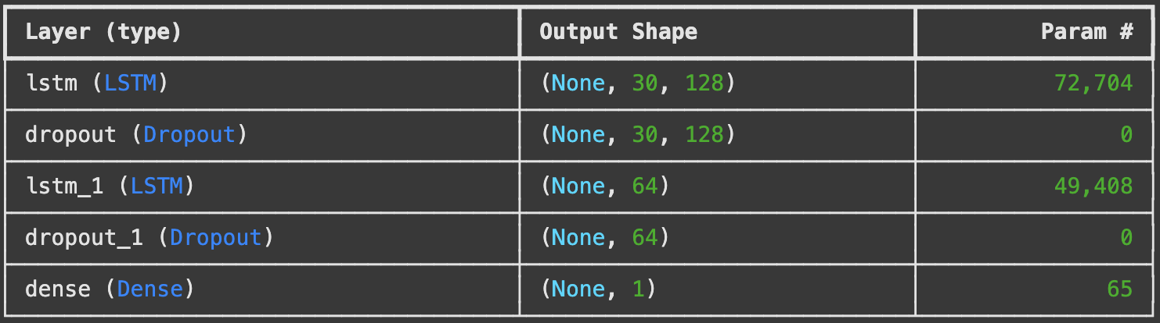
LSTM architecture
Notes:
And here’s our lstm architecture, it includes:
An LSTM layer with 128 units and dropout for regularization
A second LSTM with 64 units, followed by another dropout
A final dense layer for outputting a single predicted value
The model was compiled with the Adam optimizer and trained using mean squared error loss for 50 epochs

Slide 14
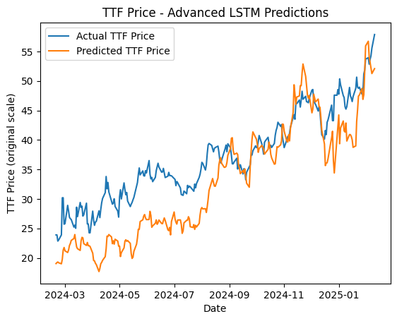
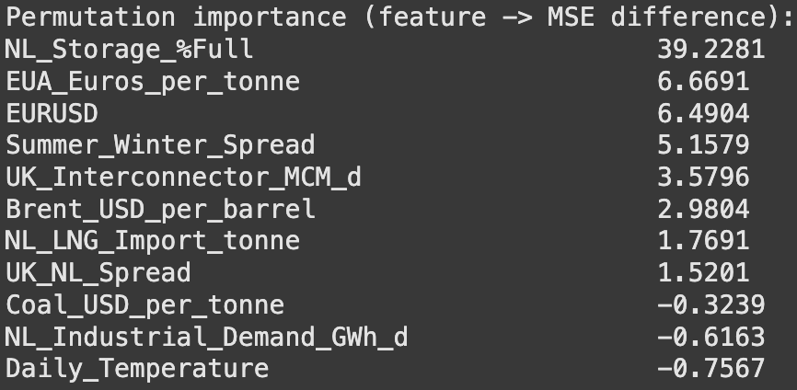
LSTM Prediction Results
Test MSE: 34.68
RMSE: 5.89
MAE: 4.98
Notes:
After training, I evaluated the model on the test set (20% of data):
RMSE: 5.89
MAE: 4.99
means on average, the model’s predictions differ from the true TTF price by about 4.99
Yeah, and to understand which features the model relied on most, I also performed permutation importance analysis:
Basically for each feature, I randomly shuffled its values in the test set and observed how much the model’s MSE worsened. The larger the MSE increase, the more important the feature is.
As you can see most of them are quite important, even those negative number are very close to zero, especially NL_Storage_%Full was the most critical, increasing MSE by 39.2 when shuffled.
These results indicate reasonable performance for a volatile commodity like TTF. The predicted values track the actual price trend quite closely, but as you can see there are still rooms for improvement… so we proceed to train the second model XGBoost

Slide 15
XGBoost Model Training
X_all_flat: (1271, 390) y_all: (1271,)
Train-test split: 80/20
Model Hyperparameters:
n_estimators=200, max_depth=5
learning_rate=0.05, subsample=0.8, colsample_bytree=0.8
Optimized for generalization and avoiding overfitting
Notes:
Our second model XGBoost is a gradient boosting algorithm that's highly effective on structured tabular data. Even though XGBoost isn’t a sequence model, I adapted it for time series by flattening the same 30-day window into a single feature vector:
With 13 features and a 30-day lag, each input becomes a 390-dimensional vector.
Y_all is just the label remains the TTF price on the next day. And we are still using a 80/20 train/test split.

Slide 16
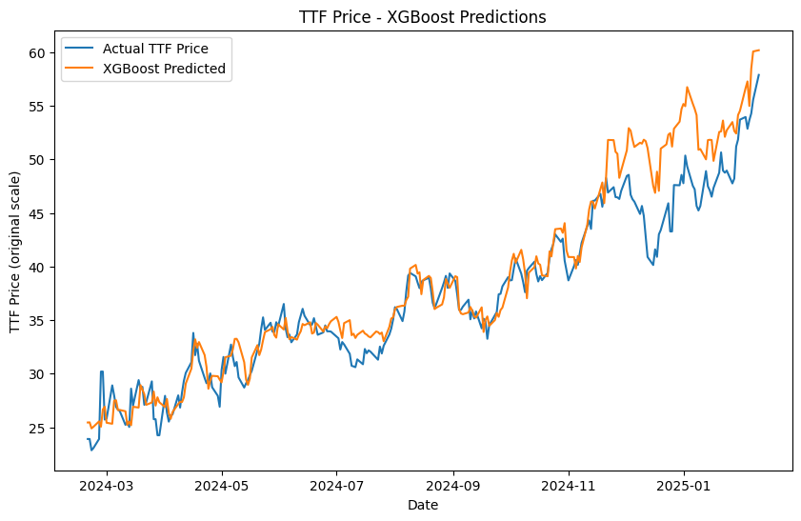
XGBoost Prediction Results
Test MSE: 8.44
RMSE: 2.91
MAE: 2.04
Notes:
After inverse-scaling the predictions:
Test MSE: 8.44 RMSE: 2.91
MAE: 2.04
This significantly outperforms the LSTM, which had an RMSE of 5.89 and MAE of 4.99.

Slide 17
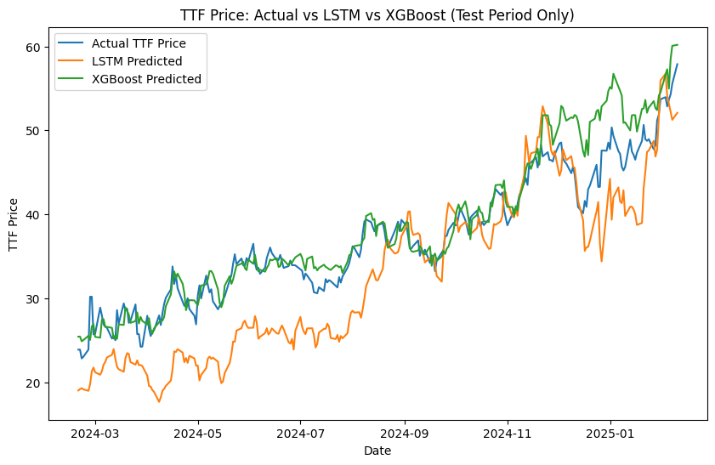
Model Comparison
We proceed with XGBoost!
Notes:
Here’s a side-by-side comparison of the predicted vs actual TTF prices from both models plotted over time. You can see that In early years, XGBoost’s predictions closely track the actual TTF prices. However in early 2025, both models diverge from reality — we wouldn’t know the reason but we suppose it could be due to:
Sudden market shocks not captured in the training data
New patterns or structural changes in energy markets (e.g., geopolitical events or policy shifts)
But given the superior accuracy and generalization, we choose to proceed with XGBoost.
· LSTMs are data-hungry and tend to perform best on large datasets with long time spans and clear seasonal trends.
· With only 1271 sequences, XGBoost may be better suited for this size dataset — it's optimized for structured data even in relatively small amounts.
· LSTM models have many parameters and are prone to overfitting, especially without regularization, early stopping, or sufficient training data.
· Even with dropout, the LSTM might have memorized noise instead of learning general patterns.
· LSTMs are sensitive to feature scaling and sequence stability.
· XGBoost is more robust to irrelevant features and noise, and can effectively select and weigh the most predictive features through its ensemble of trees.
Sometimes a simpler model like XGBoost wins, especially on structured data with limited sequence complexity or when data volume is not large enough to justify deep architectures like LSTM.

Slide 18
Correlation & Cointegration
TTF vs Brent: 0.6251
TTF vs EUA: 0.5326
Correlation
TTF vs Brent:
Test Statistic: -3.7145
p-value : 0.0176
Critical vals : [-3.90488438 -3.34083411 -3.04771407]
TTF vs EUA:
Test Statistic: -2.9870
p-value : 0.1133
Critical vals : [-3.90488438 -3.34083411 -3.04771407]
Cointegration
Notes:
So after we have the price prediction, we want to choose our strategy, Natural gas and oil both serve overlapping energy demands—industrial processes, power generation, and heating. Base on our research, from a fundamental perspective, the partial substitutability of gas, oil and carbon, along with historic pricing links, supports the idea of a stable, mean-reverting spread. If one commodity deviates too far from its “fair” relationship to the other, arbitrage and fuel-switching pressures should eventually pull their prices back toward equilibrium. So we look at the correlation results for TTF versus Brent and TTF versus EUA carbon. We see moderate positive correlations—about 0.63 for TTF–Brent oil price and 0.53 for TTF-carbon price —indicating that both pairs often move together in the short run. However, when we test for cointegration, TTF and Brent show a statistically significant long-run equilibrium relationship at the 5% level, whereas TTF and carbon do not.
Cointegration means TTF and Brent prices aren’t just moving together superficially; they actually revert toward a stable price spread over time. This makes a spread trading strategy—where we go long TTF and short Brent when TTF appears undervalued, or vice versa—more promising. The reversion in their cointegrated spread provides a stronger statistical anchor.
Meanwhile, TTF and EUA carbon, although moderately correlated, lack evidence of a long-run price relationship, so the spread may wander indefinitely rather than revert. We can treat TTF–carbon as a base case of ‘correlated but not cointegrated,’ underscoring why TTF–Brent could be better suited for a pairs or spread strategy. Now moving to our strategy

Slide 19
TTF Spread Trading Strategy
Machine Learning-Based Energy Market Trading
Notes:
As mentioned by Ben we have developed and backtested this strategy over the period from March 2024 through January 2025. Our objective was to develop a profitable trading strategy for TTF natural gas by exploiting price relationships with other energy commodities.

Slide 20
Two ML models developed: LSTM neural network and XGBoost
Both models tracked TTF price trends from €30 to €60
XGBoost performed better overall
Notes:
Let's start by looking at our prediction models. As you can see in this chart, both models tracked the general price trend reasonably well. The XGBoost model, shown in green, generally performed better overall. This comparison was critical in our decision to use XGBoost as the foundation for our trading signals.

Slide 21
Trading Strategy Mechanics
Calculate rolling 30-day TTF/Carbon and TTF/Brent ratios
Explanation: Average of TTF price ÷ Carbon price over past 30 days
Formula: Rolling_Ratio = Average(TTF_Price ÷ Commodity_Price, 30 days)
Determine "implied TTF price" using these ratios
Explanation: Today's Carbon/Brent price × Rolling average ratio
Formula: Implied_TTF = Today's_Commodity_Price × Rolling_Ratio
Notes:
Our strategy is built on a simple concept: energy commodities like TTF gas, Brent oil, and Carbon permits maintain certain price relationships over time. When these relationships temporarily deviate, there may be trading opportunities.
We implemented this by calculating a rolling 30-day average ratio between TTF and either Carbon permits or Brent oil. This ratio represents the 'normal' relationship between the commodities. We then multiplied this ratio by the current Carbon or Brent price to get what we call the 'implied TTF price' - essentially what TTF should be trading at based on historical relationships. The key insight is comparing our XGBoost model's prediction to this implied price. When they diverge, it suggests potential mispricing that we can exploit through spread trading.

Slide 22
Trading Strategy Mechanics
When XGBoost > Implied TTF: Long TTF, Short Carbon/Brent
Explanation: TTF is undervalued relative to Carbon/Brent
When XGBoost < Implied TTF: Short TTF, Long Carbon/Brent
Explanation: TTF is overvalued relative to Carbon/Brent
Implement dynamic position sizing based on price ratios
Explanation: If TTF costs 2× Carbon, take 2× position in Carbon
Formula: Carbon_Position_Size = TTF_Position × (TTF_Price ÷ Carbon_Price)
Notes:
When our XGBoost model predicts a higher TTF price than the implied price, we interpret this as TTF being undervalued relative to Carbon or Brent. In this case, we go long TTF and short the other commodity. Conversely, when XGBoost predicts a lower TTF price than implied, we interpret this as TTF being overvalued, so we short TTF and go long the other commodity. Importantly, we also implemented dynamic position sizing based on price ratios. For example, if TTF costs twice as much as Carbon, we take twice the position size in Carbon to balance our exposure.

Slide 23
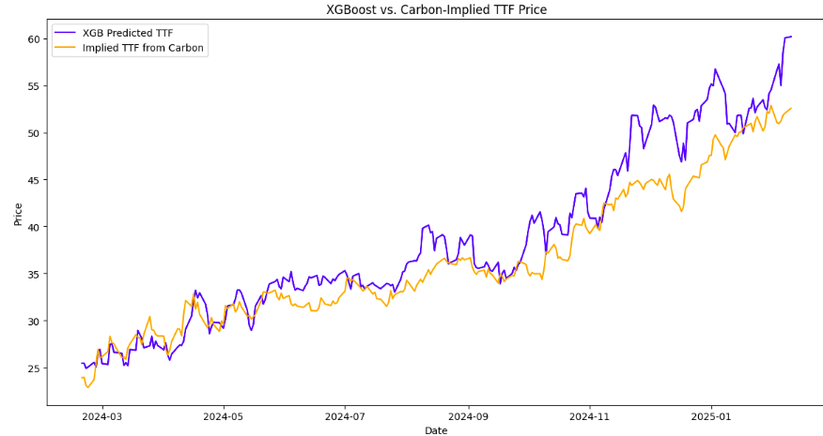
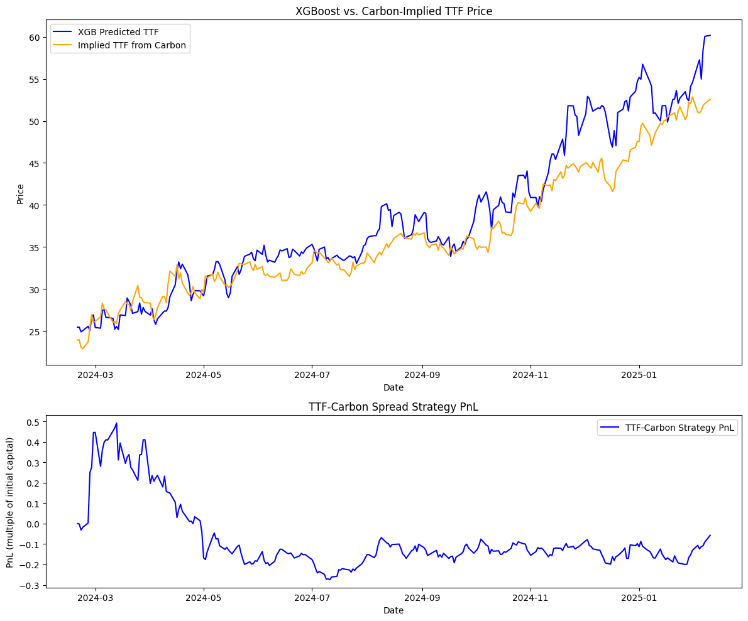
TTF-Carbon Strategy Results
Strong initial performance: Great returns in March-May 2024
Model and Carbon-implied prices initially aligned well
Persistent gap developed between predictions and Carbon-implied prices
XGBoost consistently valued TTF higher than Carbon relationship suggested
Final performance: approximately -5%
Notes:
Looking at the TTF-Carbon strategy results, we can see two distinct periods. Initial performance was very strong, with the strategy generating approximately 50% returns in March-April 2024. However, from May 2024 onward, the strategy experienced a prolonged drawdown. By the end of our testing period, this strategy ended with approximately a 5% loss.

Slide 24
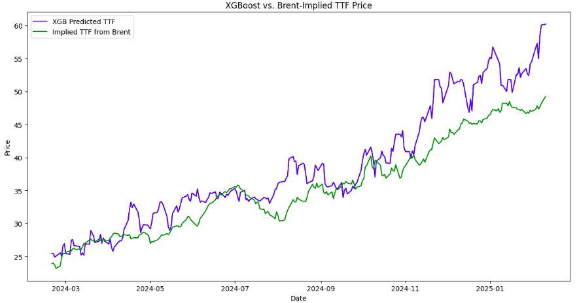
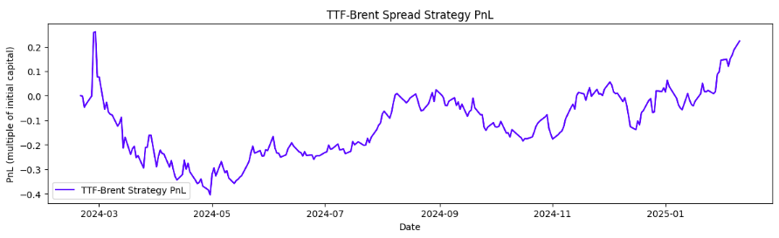
TTF-Brent Strategy Results
Brief positive start followed by significant drawdown (-40%)
Steady recovery beginning July 2024
Strong performance from November 2024 onward
Gap between XGBoost and Brent-implied prices validated by market action
Final performance: +22% return
Notes:
The TTF-Brent strategy shows a different pattern. After a brief positive period in early March, the strategy experienced a significant drawdown in April-May 2024, losing approximately 40% of initial capital. However, beginning in July 2024, we see a steady recovery, and from November 2024 onward, the strategy performed well. By January 2025, it had not only recovered all losses but generated a positive return of approximately 22%.

Slide 25
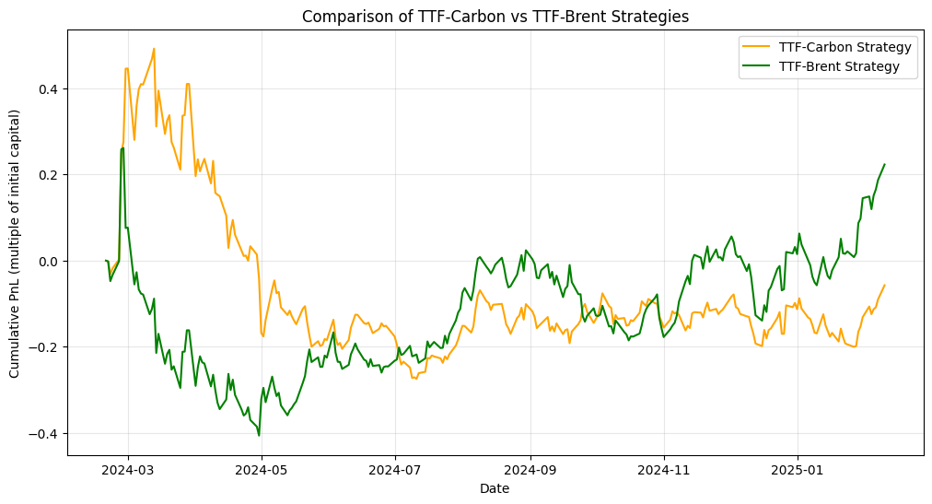
Strategy Comparison
TTF-Carbon: Better early performance but ended negative
TTF-Brent: Deeper initial drawdown but strong recovery
Significant performance divergence from November 2024
TTF-Brent relationship more reliable for long-term trading
Different commodities provide varying opportunities across market regimes
Notes:
Comparing both strategies directly, we see they had very different performance profiles. The TTF-Carbon strategy performed better in the early period but ultimately ended with a negative return. The TTF-Brent strategy had a deeper initial drawdown but demonstrated recovery and ended strongly positive. The TTF-Brent relationship may be more reliable for long-term trading. This pattern indicates that different commodities may provide better spread trading opportunities during different market regimes.
Moving forward, we see several avenues for further development: The strategy shows promising long-term performance but requires risk management to handle the initial drawdown period.

Slide 26

Improving with risk management and hedging

Slide 27
Risk Management & Hedging features
Volatility and Deviation based position sizing
Trailing Stop loss of 5%
Spread Strategy Diversification (Coal and Brent)
Notes:
Volatility here is the spread volatility between TTF and another asset like carbon or Brent. The idea is that if the spread is more volatile, they take a smaller position to control risk. That makes sense because higher volatility means more risk, so reducing position size helps manage that risk.
Volatility calculations are done using a rolling window (20 days), which adapts to changing market conditions.

Slide 28
Code Mechanics
Stop Loss: 5%
Position Sizing:
Position Scale / Asset Spread Volume * (XGBoost - implied TTF) / Implied TTF)
Reverse when signal Changes
Notes:
So after playing around with the parameters, we found a stop loss of 5% to be good. striking a balance between risk and returns.
Asset spread volume measures How strongly one asset is trending away from the other
While the last parameter measures how strong our signal is. The percentage price deviation between predicted price an implied price
We switch the position once the signal reverses or once we hit a cummulative drawdown of 5% on our combined trades in both direction either in negative or positive

Slide 29
Code Mechanics
Carbon Spread Volume (20MA)
= √252 × σ ×(ΔTTF - ΔCarbon × TTF/Carbon)
Notes:
This measures how drastically TTF is trending away from carbon either Having its price appreciate over carbon or depreciate.
In a perfectly ideal asset pair. The spread deviation will be close to 0 but sometimes correlated do show behaviour trending away from one another
If there is a strong trend of It moving away, we want to reduce the position size to manage risk
The rolling volatility of the carbon spread return is calculated over a lookback window of 20. Mathematically, this is expressed as the standard deviation of the carbon spread returns over the last n days, annualized:

Slide 30
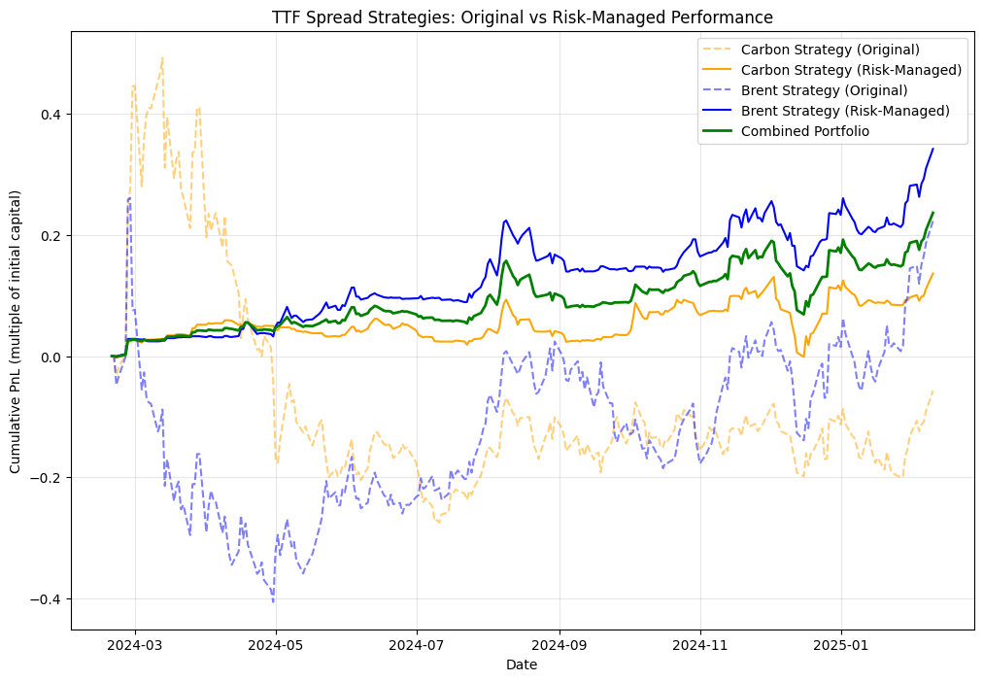

Slide 31
Strategy Performance
 | Carbon Strategy | Brent Strategy | Combined Portfolio
Total Return | 9.52% | 28.66% | 18.90%
Sharpe Ratio | 0.74 | 1.92 | 1.49
Max Drawdown | -11.93% | -8.70% | -10.00%
Win Rate | 49.02% | 53.73% | 52.94%
Number of Trades | 127 | 128 | 128
Avg Trade Duration | 6.4 days | 7.4 days | 6.9 days

Slide 32
Thank you

Slide 33
Q&A

